Slide 1
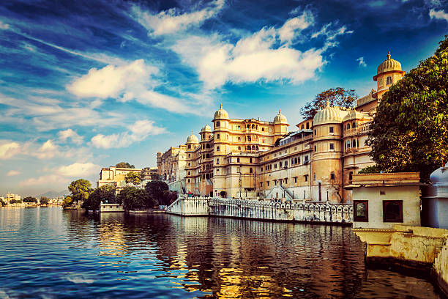
Hotel booking analysis
Presented By : - Jayant S. Bhoyar
Guided By :- Abhishek Wavhal

Slide 2


Point For Discussion
Summary Of Data
Data Wrangling
Data Analysis
Data Visualization
Conclusion

Slide 3

Summary Of Data
The Dataset Has A Shape Of 119,390 Which Mean That It Contains 119,390 Rows And 32 Columns
This Data Set Contain Booking Information For A City Hotel And Resort Hotel
It Includes Information Such As When The Booking Was Made, Length Of Stay , Lead Time, And An Arrival Date Year , Repetition Of Guests , their Food Choices Among Other Things.
Before Visualize Any Data From The Dataset We will Do The Data Cleaning As To Fill Any Null Values And Delete Any Duplicate Values After We Have To Do Data Wrangling.
And We Will Also Take Help Of Charts For Better Analysis.

Slide 4
Data Wrangling
Data Cleaning :-
Remove Duplicates :- We Found 31,994 Duplicate Rows In The Dataset. These Rows Were Removed To Maintain Data Accuracy And Eliminate Redundancy During Analysis.
Added New Columns : total stay (weekend + weekday nights)
Total num people : (adults + children + babies)
There Are 4 Columns In Dataset Which Is Having Missing Values And Those Columns Are Company, Agent, Country And Children.

Slide 5
Data Analysis
What is the cancellation rate across hotel types?
What’s the most booked room type?
Which months have the most hotel bookings?
Which country has the most bookings?
How many people booked each year?
What is the average daily rate (ADR)?
What are the most popular
meal types?
What is the distribution of time? lead
Which hotel type had more bookings?
What’s the average stay length for weekends vs weekdays?

Slide 6

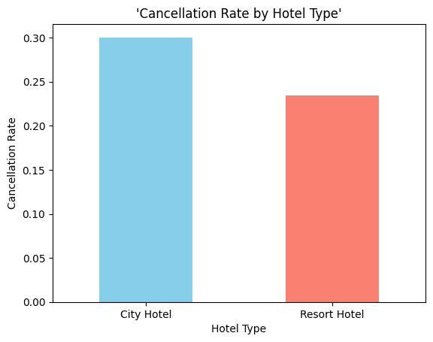
The Cancellation Rate Across Hotel Types
City Hotel has a cancellation rate of about 30%.
Resort Hotel has a cancellation rate of about 23%.
City Hotels face more cancellations than Resort Hotels
How we can help the business : -
City hotels may need to review their cancellation policies.
They could offer non-refundable discounts or booking incentives to reduce cancellations.
Helps plan better and avoid empty rooms that reduce revenue.

Slide 7
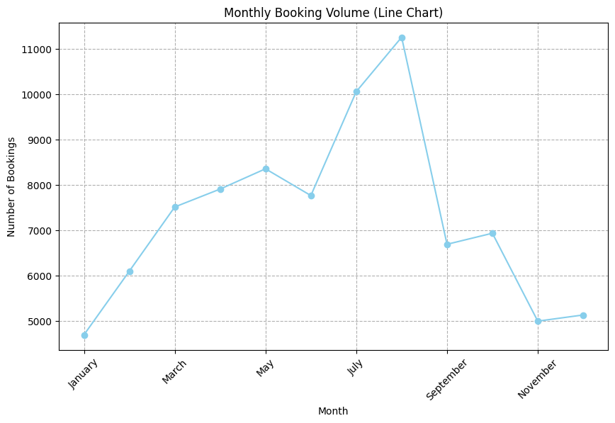
Which Months Have The Most Hotel Bookings
August recorded the highest number of bookings (over 11,000).
This suggests summer (July–August) is the busiest travel season.
January, November, and December see the lowest bookings
How we can help the business : -
Focus advertising and deals around summer for maximum returns.
Offer seasonal packages during low seasons (January, November).
Notes:
“Monthly Booking Volume & Insights”

Slide 8
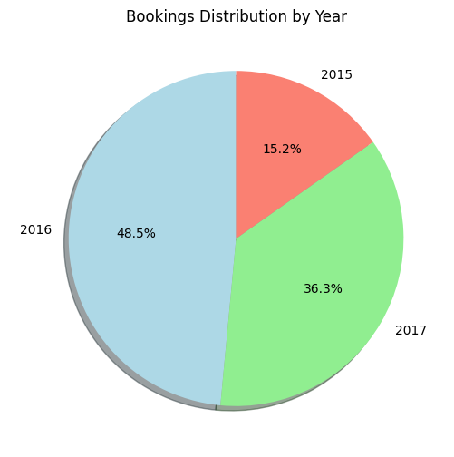
How Many People Booked Each Year
The majority of bookings (48.5%) were made in 2016, showing a strong business year.
36.3% of total bookings occurred in 2017, indicating a slightly lower but stable performance compared to 2016.
Only 15.2% bookings in 2015 — possibly a start-up phase or lower brand awareness.
How we can help the business : -
Use insights to identify successful strategies from 2016 and apply them to future plans.

Slide 9
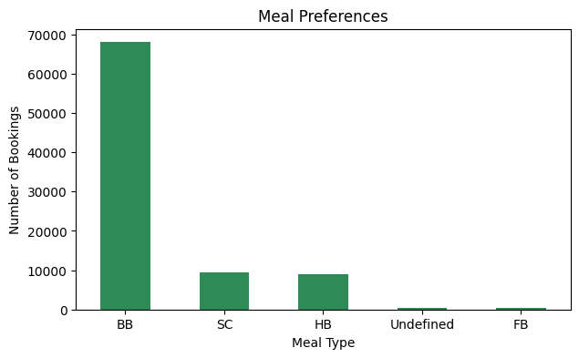
What are the most popular meal types
BB (Bed & Breakfast) is the most preferred option – over 68,000 bookings.
SC (Self Catering) and HB (Half Board) follow with around 9,000 bookings.
FB (Full Board) and Undefined are the least chosen
How we can help the business : -
Focus on promoting BB packages – aligns well with guest preferences.
SC or HB options with discounts
Investigate why FB and Undefined options underperform

Slide 10
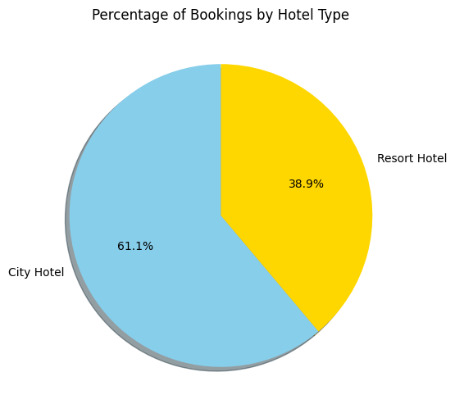
Which Hotel Type Had More Bookings
City Hotels hold the majority share (61.1%) of total bookings.
Resort Hotels make up 38.9%
How we can help the business : -
Invest in expanding or upgrading City Hotel services (Wi-Fi, business centers.
Develop targeted marketing campaigns for Resort Hotels highlighting relaxation, experiences, and deals.

Slide 11
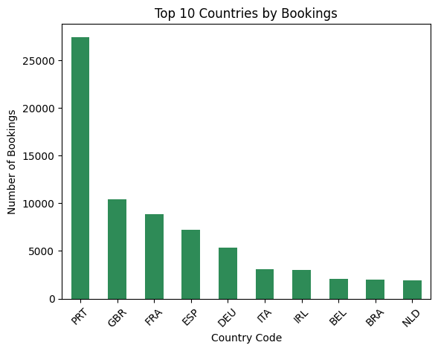
Which country has the most bookings
Portugal (PRT) is the leading country, contributing over 27,000 bookings.
United Kingdom (GBR) and France (FRA) follow with strong booking volumes (~10,000 and ~9,000 respectively).
How we can help the business -
Targeted marketing can be run in high-performing countries. For low-performing ones, hotels can offer international deals or partner with local travel agents. Understanding guest origin helps with cultural services, payment options, and language support.

Slide 12
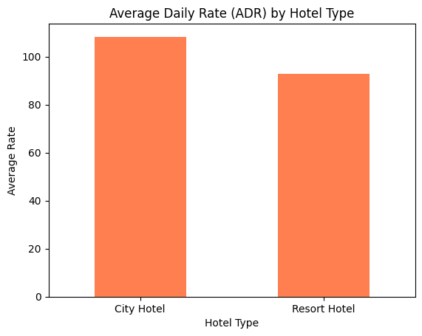
What is the average daily rate (ADR)
City Hotels have a higher Average Daily Rate (ADR).
Resort Hotels show a slightly lower ADR
How we can help the business –
Focus marketing efforts for City Hotels on business travelers or short-term high-value guests.
For Resort Hotels:
Emphasize value for money and experience-driven stays.
Upsell spa, activities, or dining packages to boost total revenue.

Slide 13
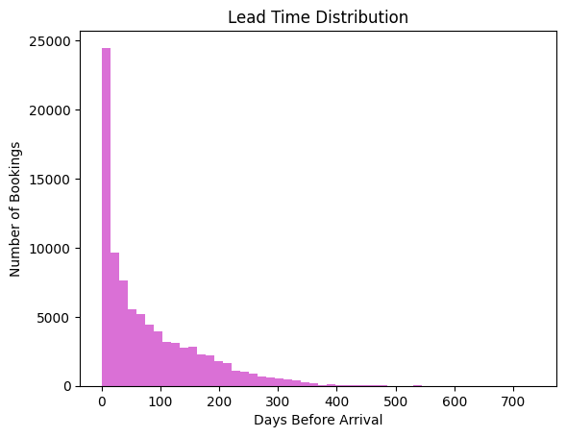
What is the distribution of lead time
How we can help the business : - Use early Guest discounts to attract planners.
Most bookings are made within the first 0 to 100 days before arrival.
A huge spike is seen at 0–30 days, meaning many people book at the last minute.
Majority of bookings are made less than 3 months before the trip.
Very few people book more than 6 months in advance.
Last-minute bookings (within 1 month) are very common.

Slide 14
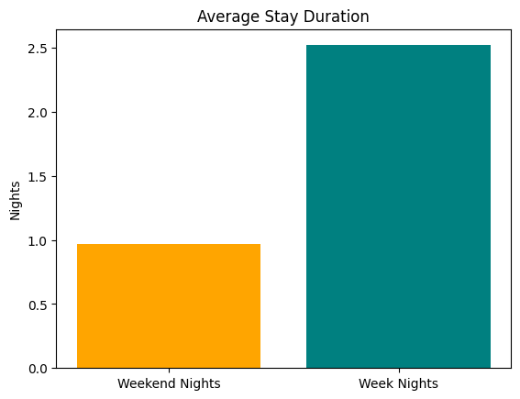
What’s The Average Stay Length For Weekends Vs Weekdays
Weekend stays are longer: Guests stay -2.5 nights on weekends.
Weekday stays are shorter: Guests stay only -1.5 nights on weekdays.
Business Tips
For Weekends:
Offer weekend packages (e.g., "3-day getaway deals").
Promote add-ons (spa, tours) to increase revenue per stay.
For Weekdays:
Target business travelers with fast check-in/out and work-friendly perks.
Use discounts to attract more weekday bookings.

Slide 15
Conclusion
City hotels experience more cancellations than resort hotels.
Peak bookings in July and August, showing high seasonal demand in summer.
Lowest in January and November, indicating off-season.
2016 had the highest share of bookings.
There was steady growth from 2015 to 2017
BB (Bed & Breakfast) is the most preferred by a huge margin.
Other types like Half Board (HB) and Self-Catering (SC) are far less common.
City Hotels received more bookings overall compared to Resort Hotels.
Portugal (PRT) leads by a large margin in bookings.
Other top contributors include UK (GBR), France (FRA), and Spain (ESP).
City Hotels charge higher rates compared to Resort Hotels.
Most guests book close to the check-in date, especially within the first 50 days.
Very few bookings are made more than 200 days in advance.
Weekday stays are longer (2.5 nights) than weekend stays (1 night), showing guests prefer extended visits during the week.

Slide 16
Any Questions ?

Slide 17
Thank You
Thank You All For Your Time And Attention. I Appreciate The Opportunity To Share This Information With You .
Thank You Again For Being A Great Audience.

